Slide 1


Three-Dimensional Box Topology Optimization with constrained space
By:
Ahmed Dawod, Talhah Ansari, Luis Dario Rueda
Supervised by:
Giovanni Filomeno, Moustafa Alsayed Ahmad
Chair of Computational Modelling and Simulation
Department of Civil, Geo and Environmental Engineering
Technical University of Munich
Munich, 2 December 2021

Slide 2

Outline
Chair of Computational Modeling and Simulation TUM School of Engineering and Design Technical University of Munich
Short Introduction
Objectives
Motivation
Implemented algorithm
Full algorithm flowchart
Final Results
2

Slide 3
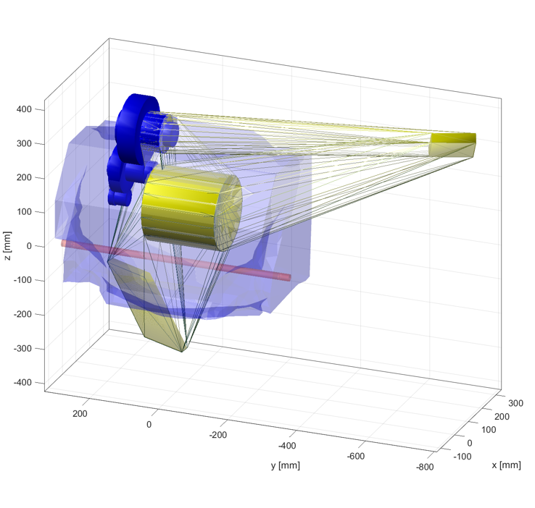
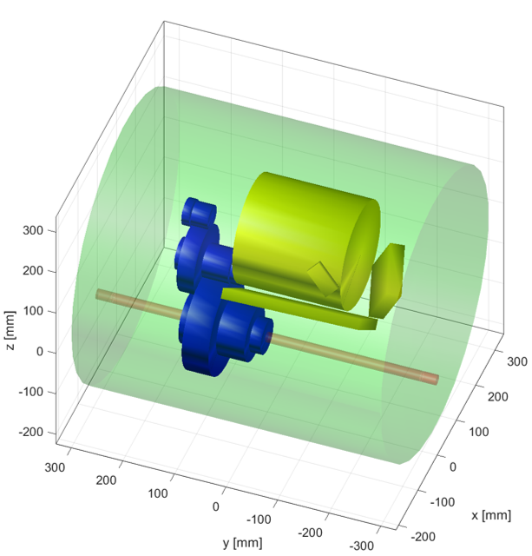
Introduction
Chair of Computational Modeling and Simulation TUM School of Engineering and Design Technical University of Munich
Objectives
The main goal is to develop an efficient algorithm for positioning a transmission assembly comprised of a gearbox assembly and a defined number of cuboids representing the electrical components in a constrained assembly space.
This positioning is to be optimized such that the components are placed as close as possible to the transmission system while avoiding collision between the different components, the gearbox, and the constrained space.
Fig.3: Transmission Components Prior to Position Optimization
Fig.4: Transmission Components after Position Optimization
3

Slide 4
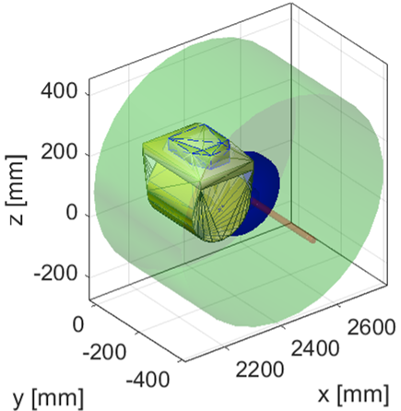
Introduction
Chair of Computational Modeling and Simulation TUM School of Engineering and Design Technical University of Munich
Motivation
Ensure that a selected gearbox coupled with its electrical components fits in the confined assembly space
Minimize volume and weight of the transmission assembly
Minimize electrical losses in cables
Fig.5: Transmission Components after Position Optimization
4

Slide 5
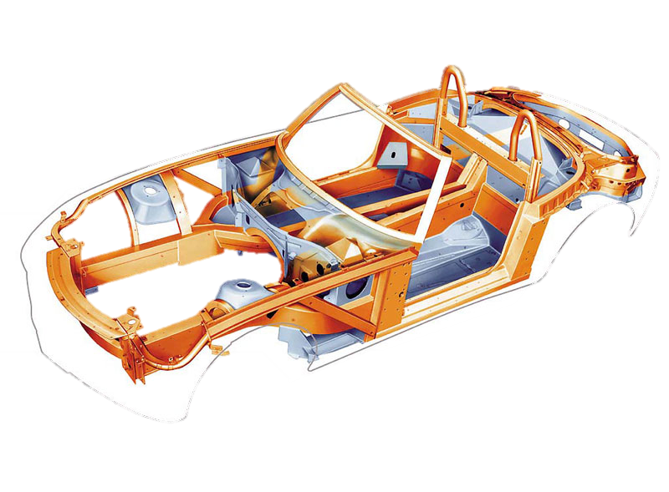
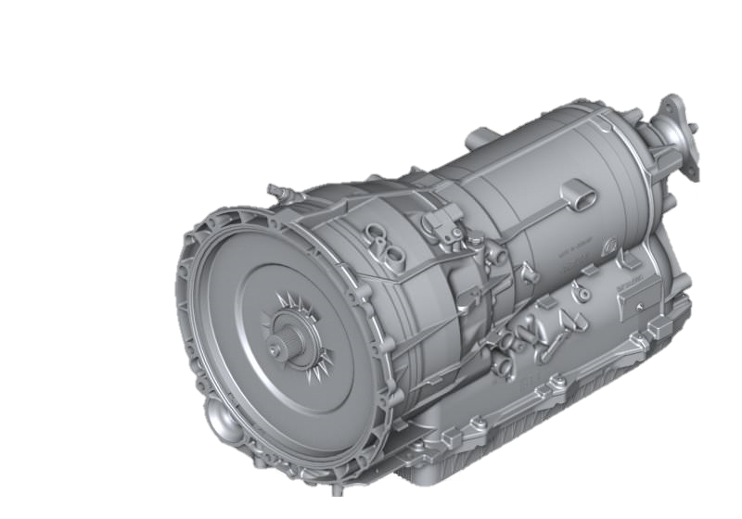
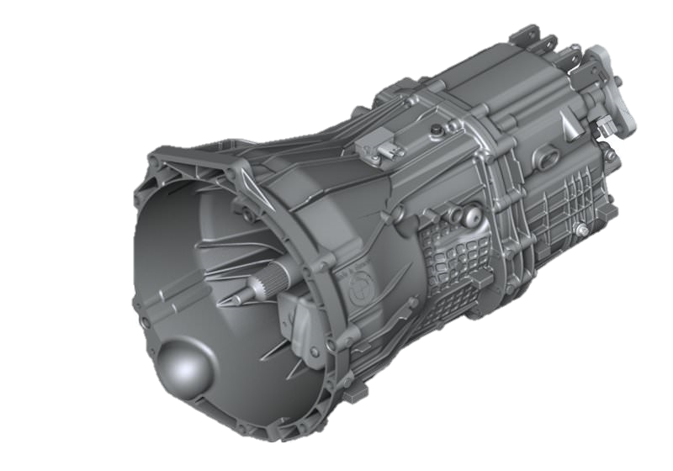
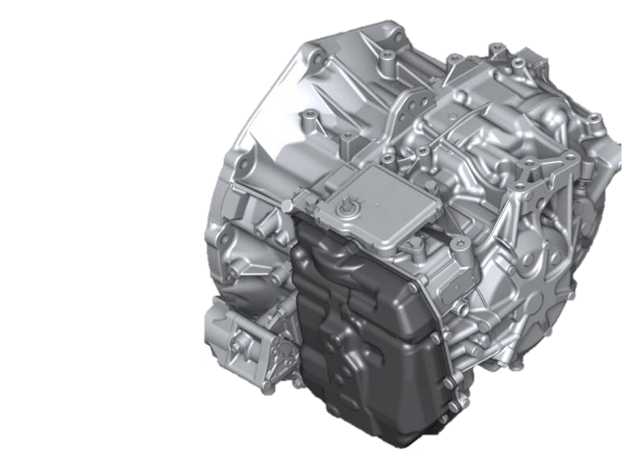
Introduction
Chair of Computational Modeling and Simulation TUM School of Engineering and Design Technical University of Munich
Motivation
To efficiently and quickly select the best transmission system solution out of multiple existing ones that can fit within a specific chassis.
Fig.6: BMW Z8 Space Frame
Fig.7: BMW Automatic transmission GA8P75HZ
Fig. 8: BMW manual gearbox GS6-45DZ
Fig.9: BMW automatic transmission GA6F21AW
5

Slide 6
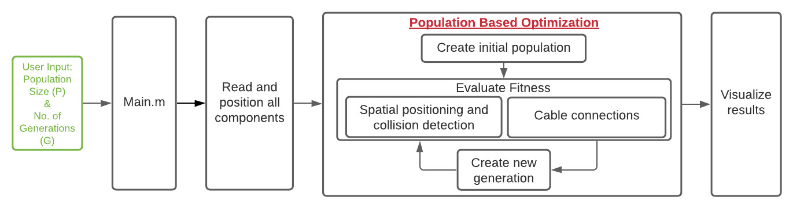
Implemented Algorithm
Chair of Computational Modeling and Simulation TUM School of Engineering and Design Technical University of Munich
6

Slide 7
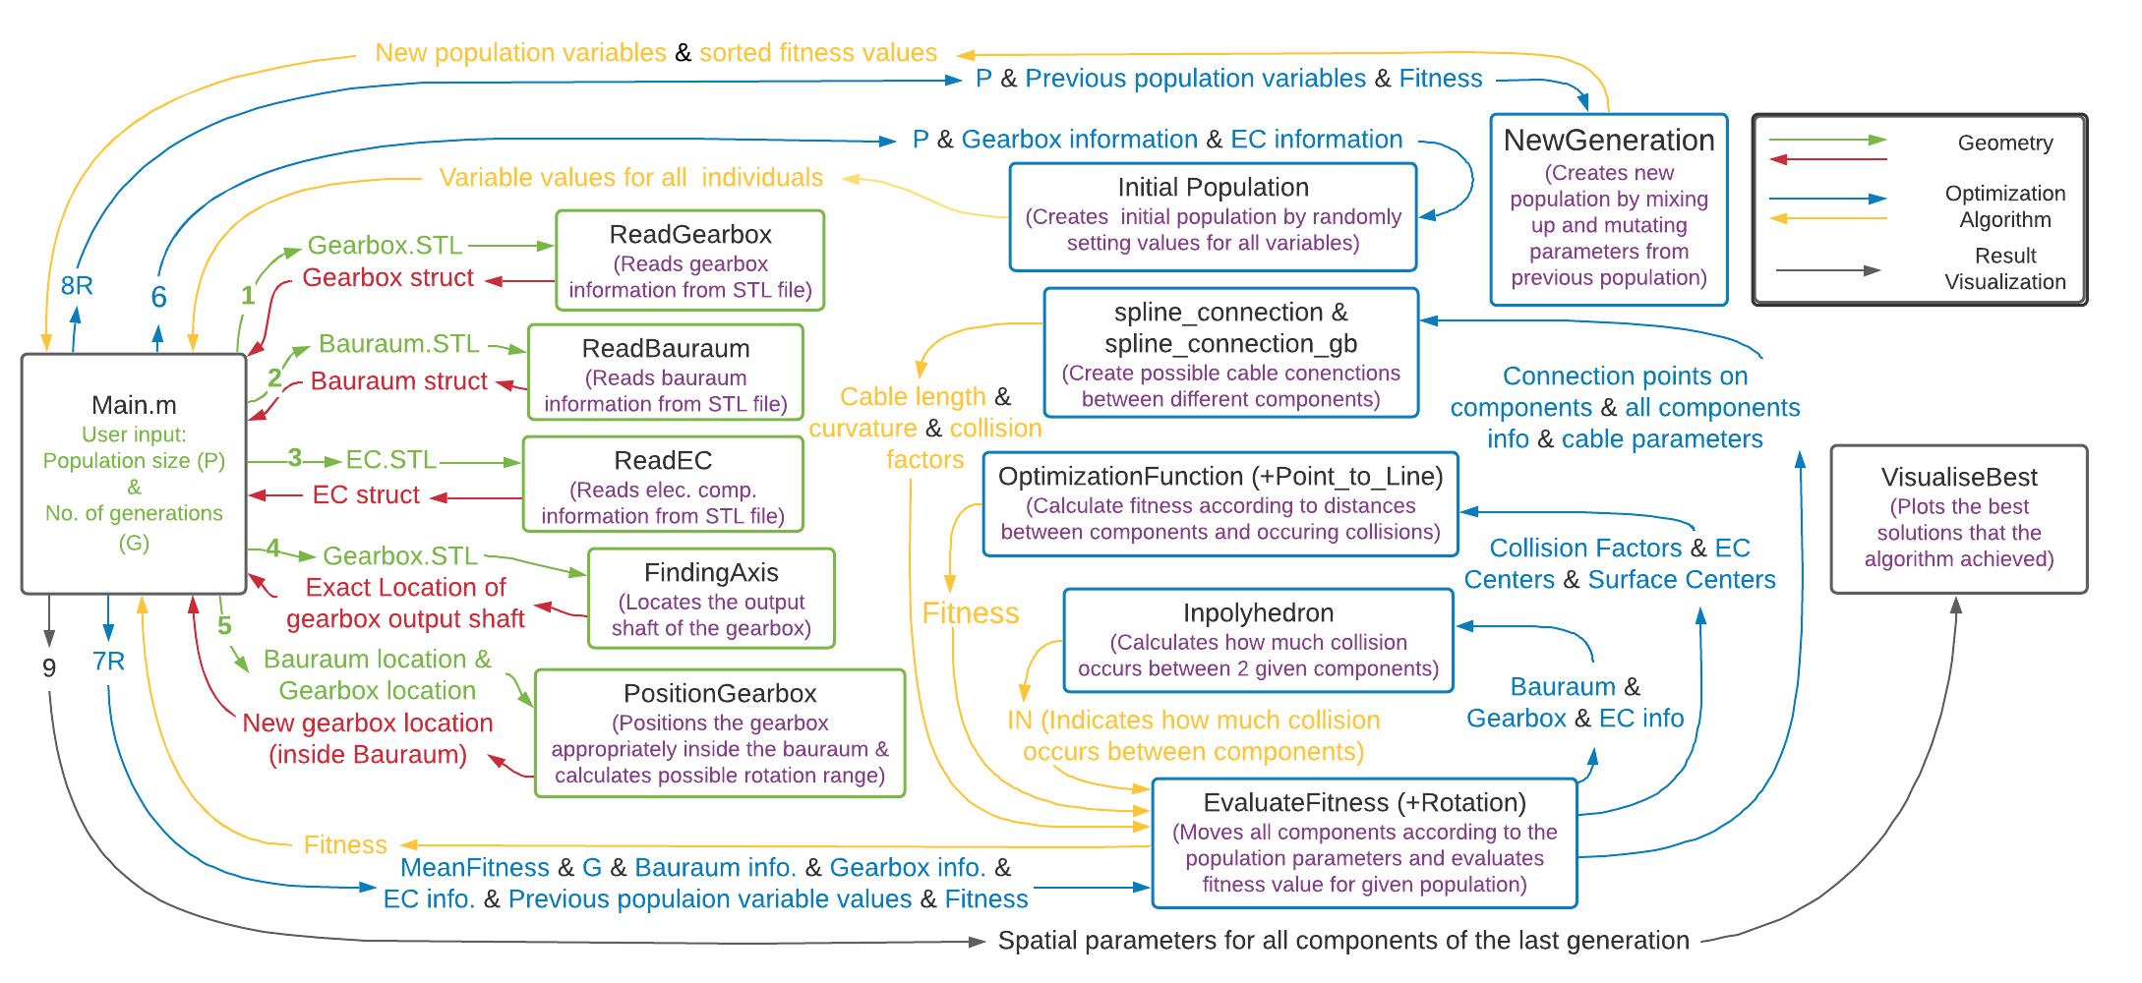
Implemented Algorithm
Chair of Computational Modeling and Simulation TUM School of Engineering and Design Technical University of Munich
7

Slide 8
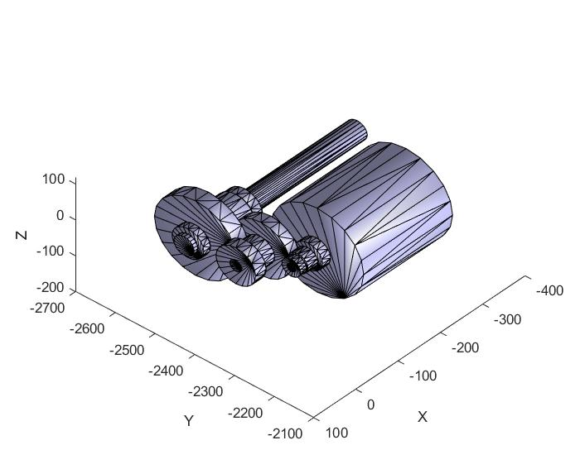
Implemented Algorithm
Chair of Computational Modeling and Simulation TUM School of Engineering and Design Technical University of Munich
1- Read Gearbox
8

Slide 9
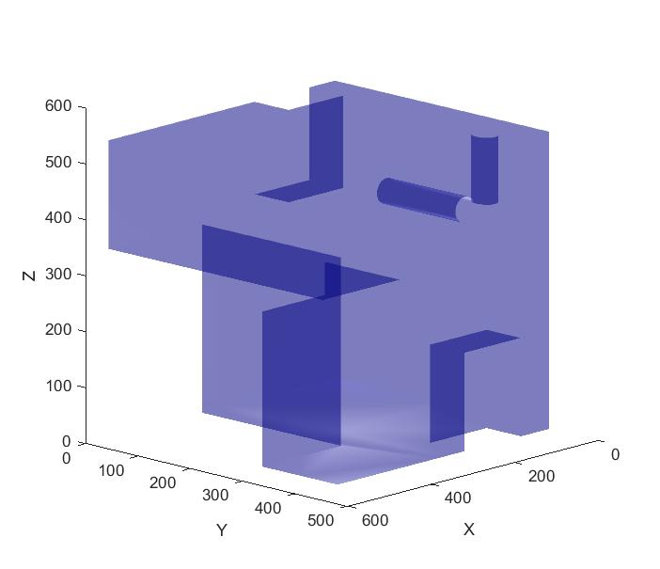
Implemented Algorithm
Chair of Computational Modeling and Simulation TUM School of Engineering and Design Technical University of Munich
2- Read Bauraum
9

Slide 10
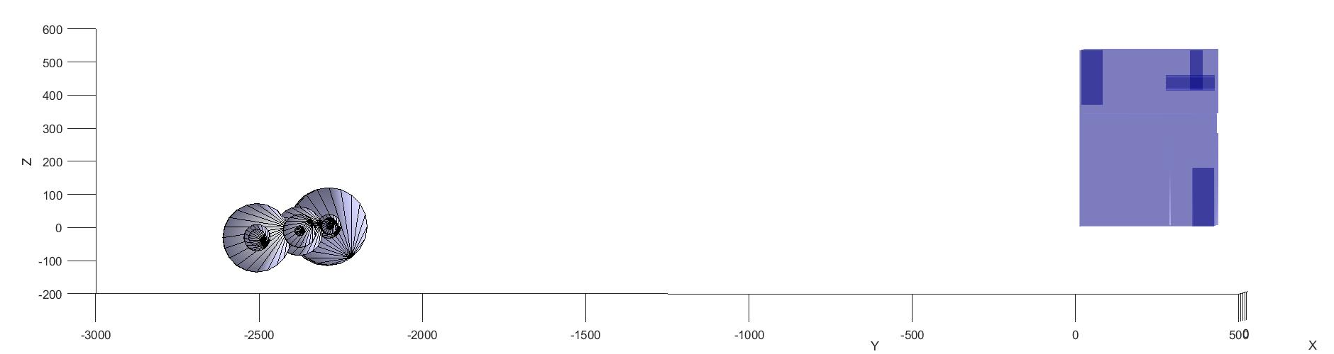
Implemented Algorithm
Chair of Computational Modeling and Simulation TUM School of Engineering and Design Technical University of Munich
ReadGearbox + ReadBauraum
10

Slide 11
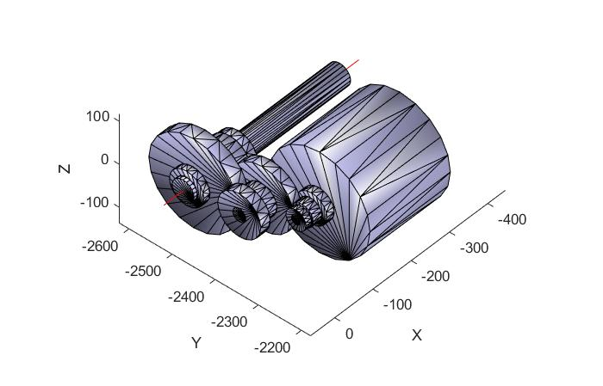
Implemented Algorithm
Chair of Computational Modeling and Simulation TUM School of Engineering and Design Technical University of Munich
4- Finding Axis
11

Slide 12
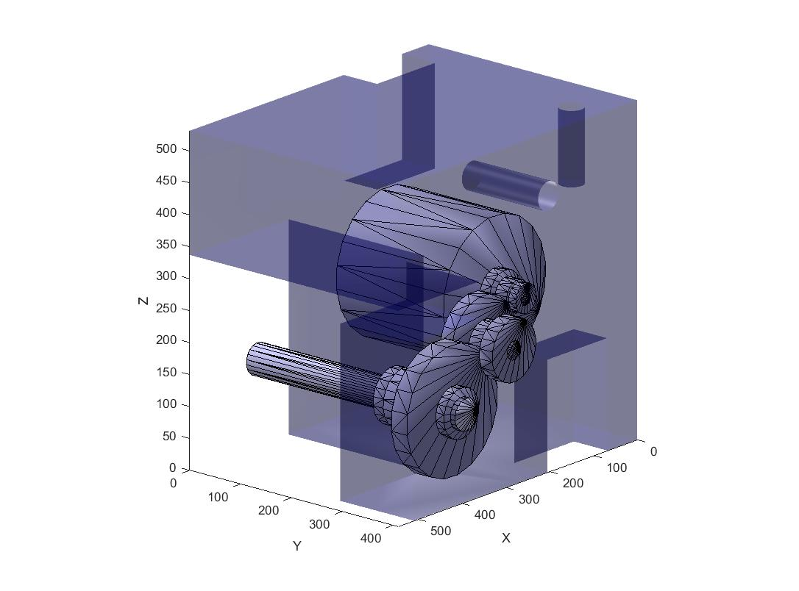
Implemented Algorithm
Chair of Computational Modeling and Simulation TUM School of Engineering and Design Technical University of Munich
5- Positioning Gearbox
12

Slide 13
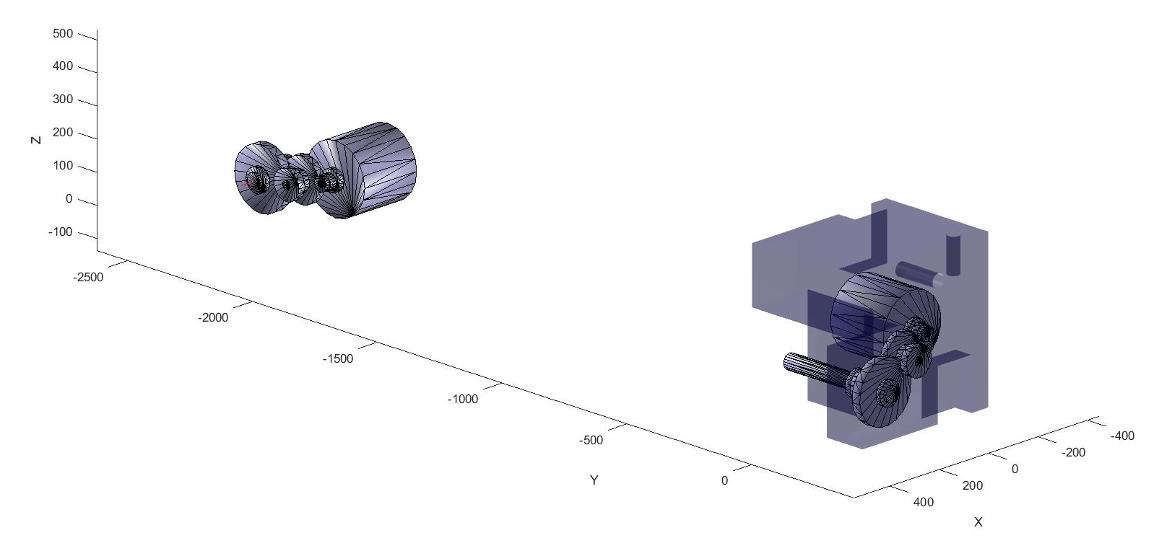
Implemented Algorithm
Chair of Computational Modeling and Simulation TUM School of Engineering and Design Technical University of Munich
5- Position Gearbox
13

Slide 14
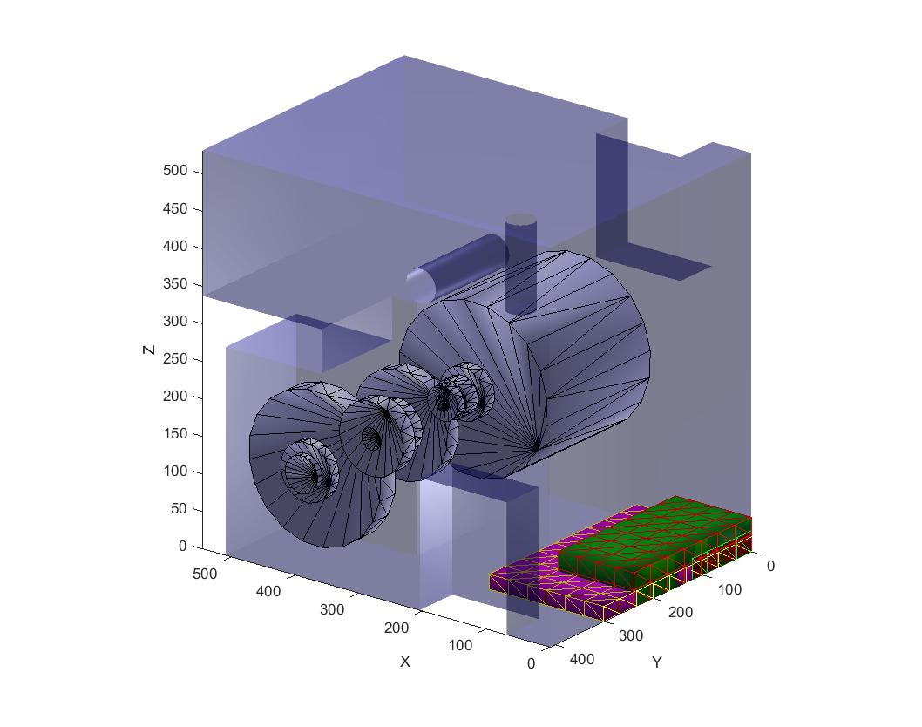


Implemented Algorithm
Chair of Computational Modeling and Simulation TUM School of Engineering and Design Technical University of Munich
3- Read EC
14

Slide 15
Implemented Algorithm
Chair of Computational Modeling and Simulation TUM School of Engineering and Design Technical University of Munich
15

Slide 16
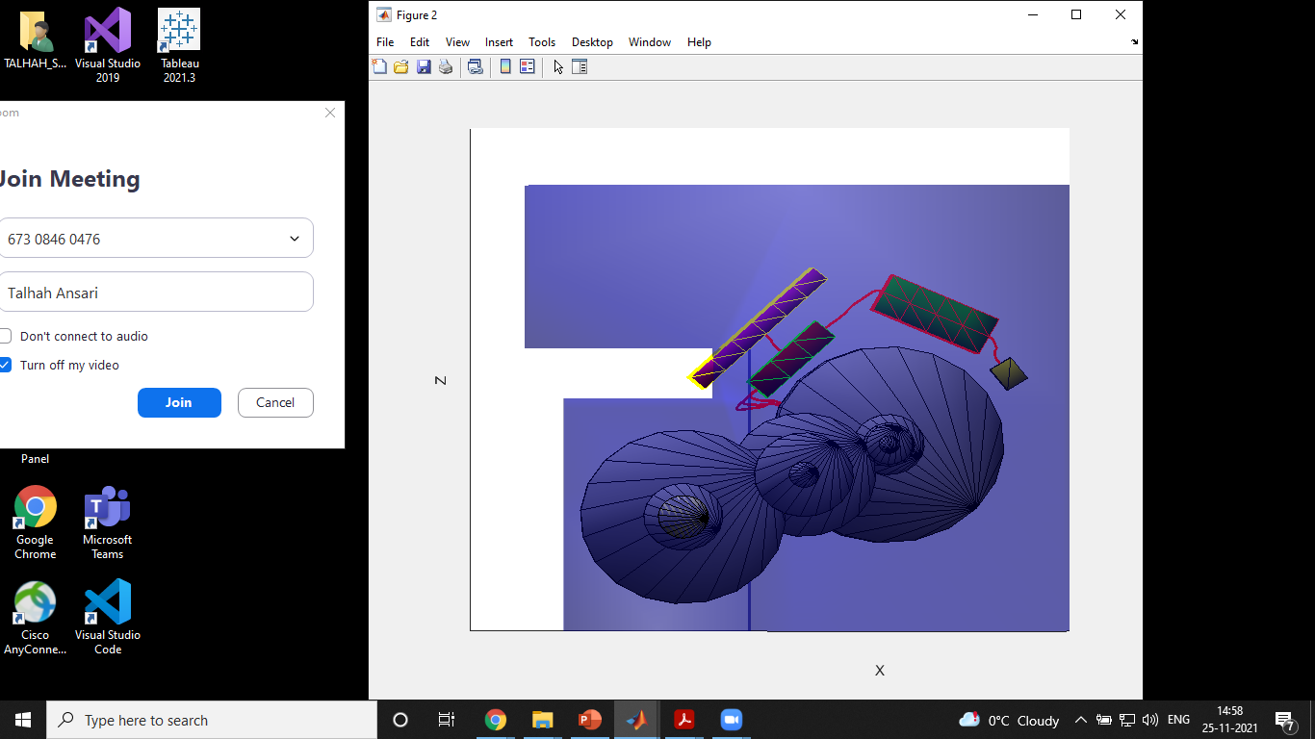
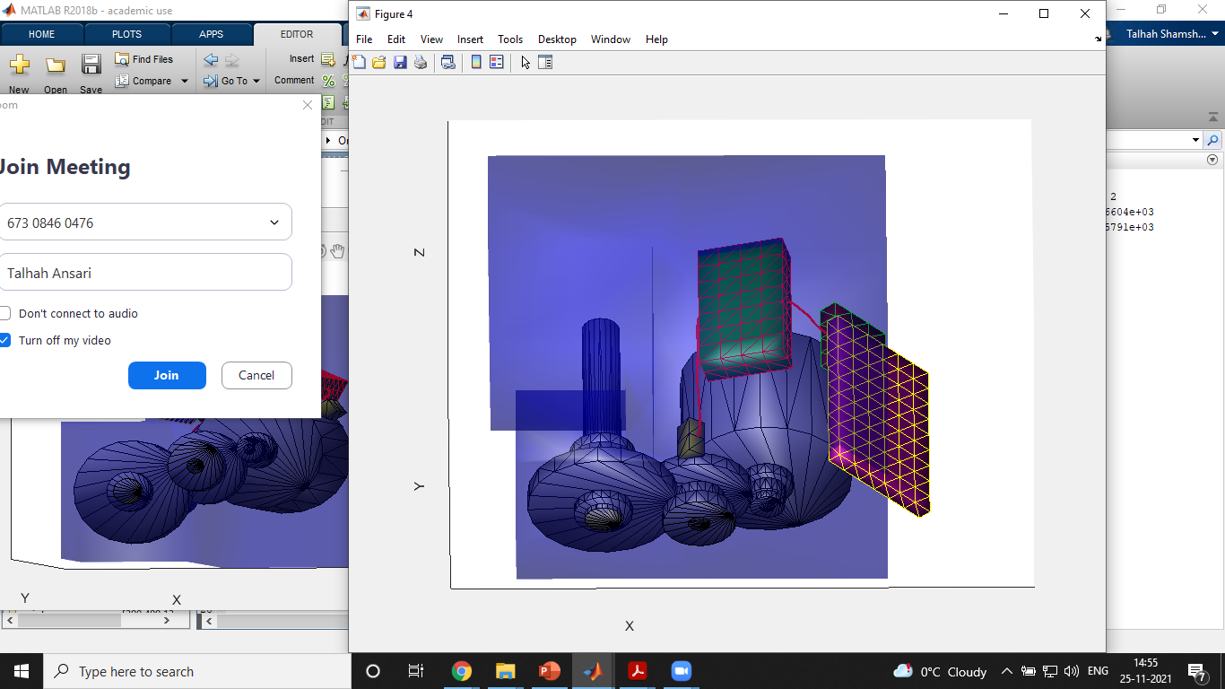
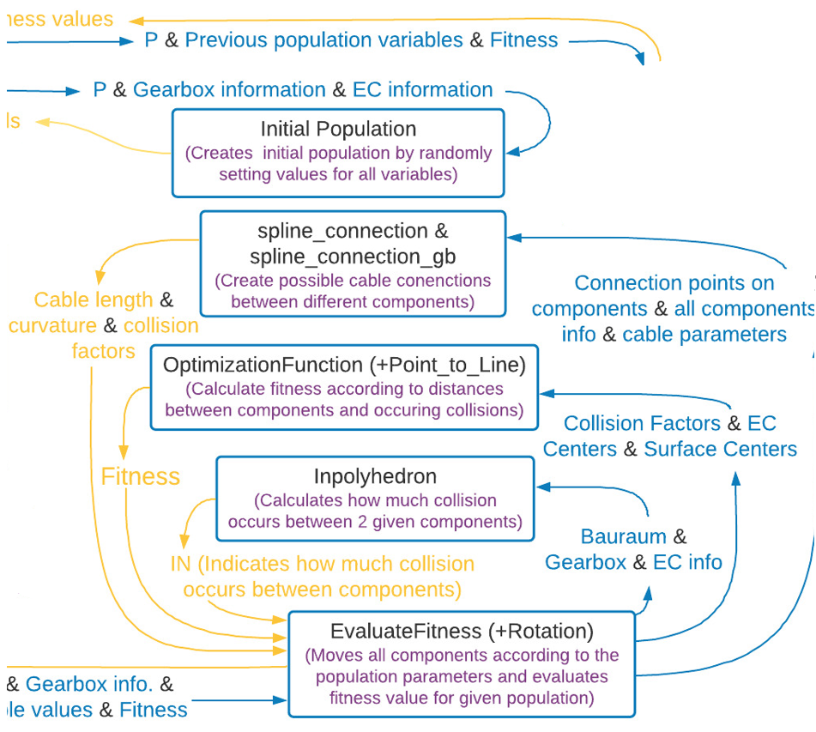
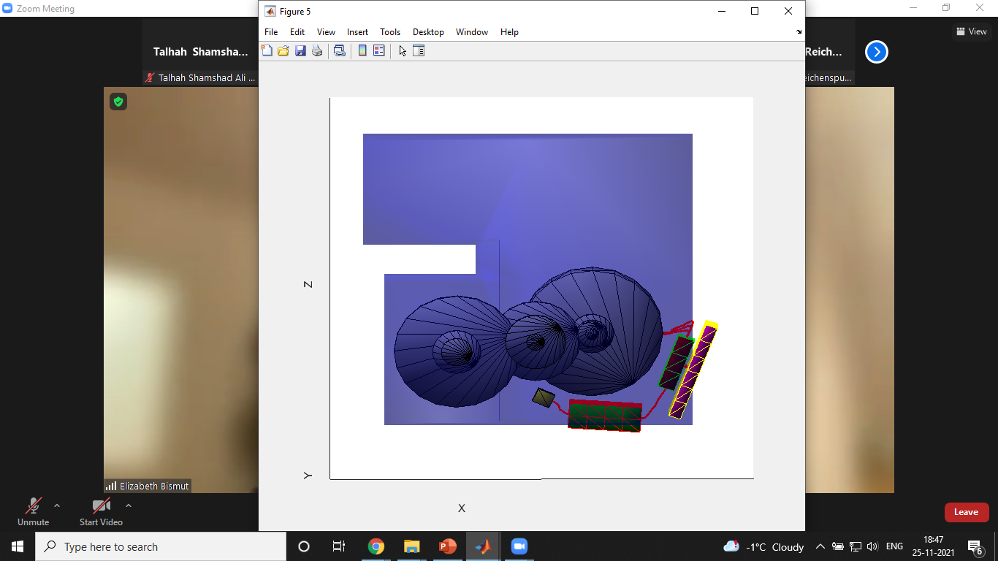
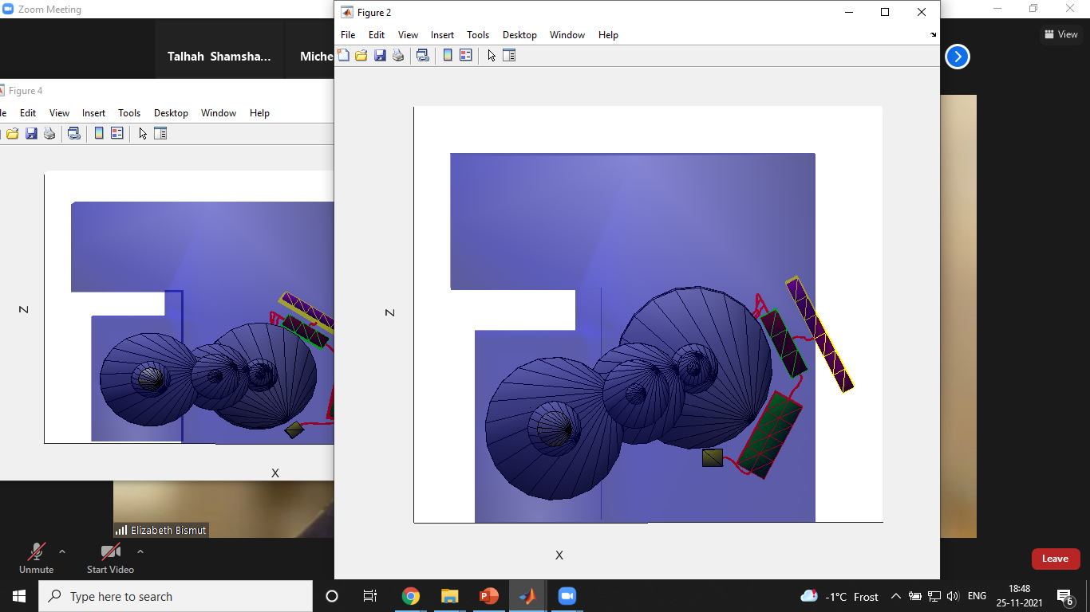

Implemented Algorithm
Chair of Computational Modeling and Simulation TUM School of Engineering and Design Technical University of Munich
Initial Population
Random
Based on
- Dimensions of the Bauraum
- Gearbox rotation range
- Connections between the Electrical components
Population size: 1000
Generation no.: 1
16

Slide 17
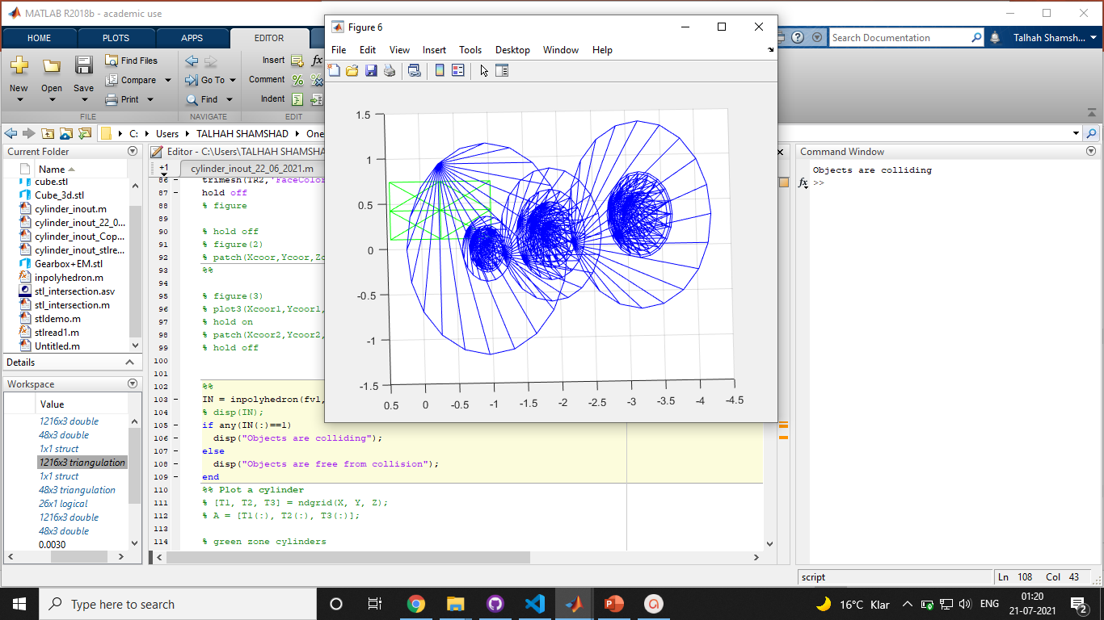
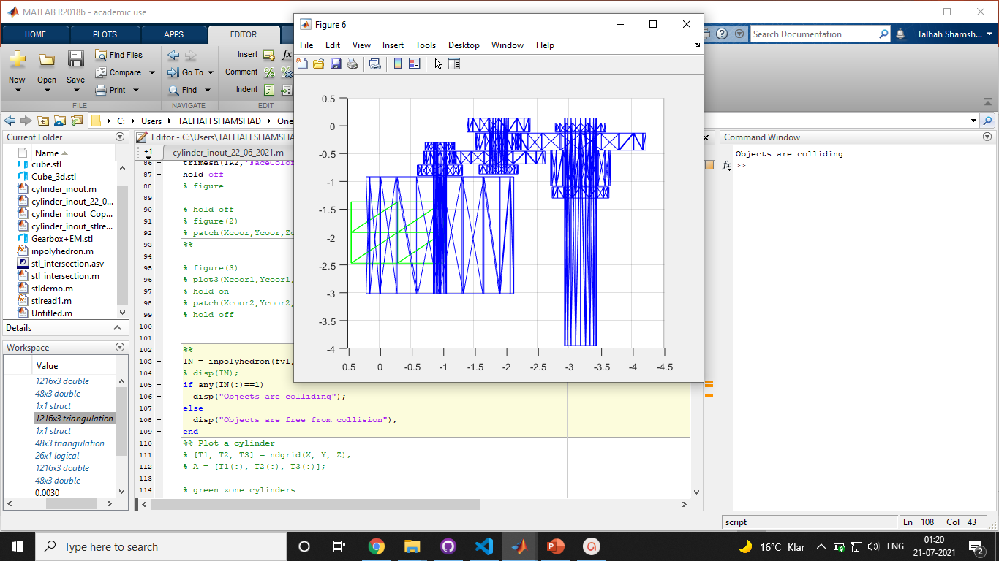
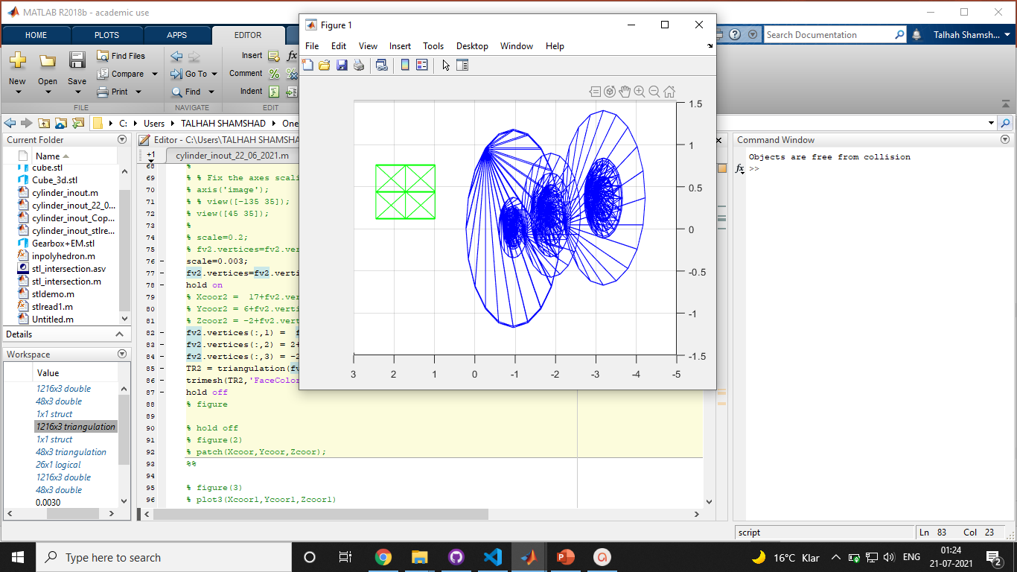
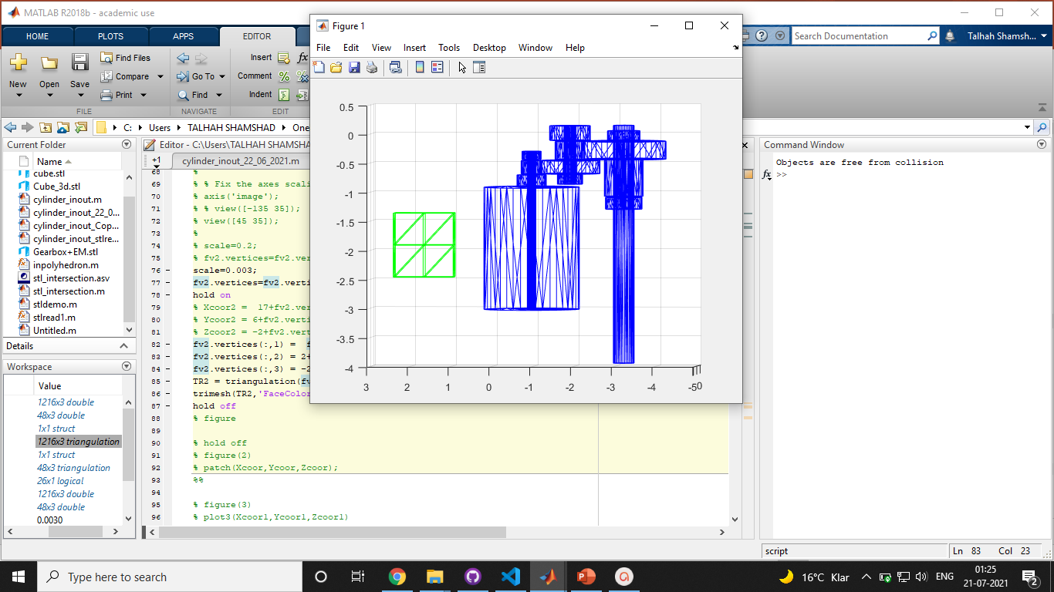
Implemented Algorithm
Chair of Computational Modeling and Simulation TUM School of Engineering and Design Technical University of Munich
Collision detection (Inpolyhedron)
17

Slide 18
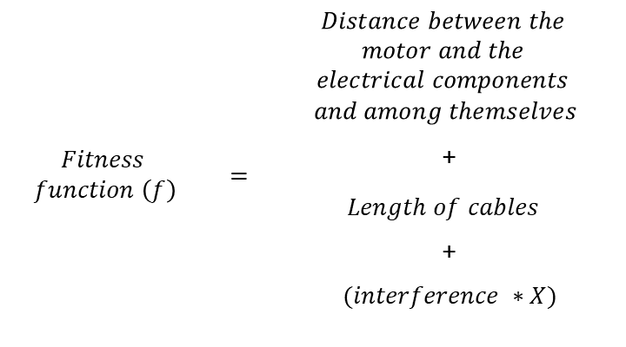
Implemented Algorithm
Chair of Computational Modeling and Simulation TUM School of Engineering and Design Technical University of Munich
Fitness Evaluation
$$Fitness$$ $function \left(f\right)$ | $$=$$ | $$\begin{aligned}Distance between the \\ motor and the \\ electrical components \\ and among themselves\end{aligned}$$
 |  | +
 |  | $$Length of cables$$
 |  | +
 |  | $$(interference ∗X)$$
Cables
where X is a large Penalty factor
This function needs to be minimized for the optimal solution
18

Slide 19
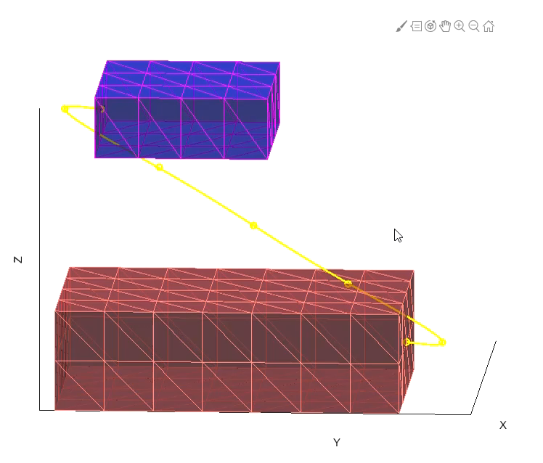
Implemented Algorithm
Chair of Computational Modeling and Simulation TUM School of Engineering and Design Technical University of Munich
Fitness Evaluation – Collision detection and penalty
19

Slide 20

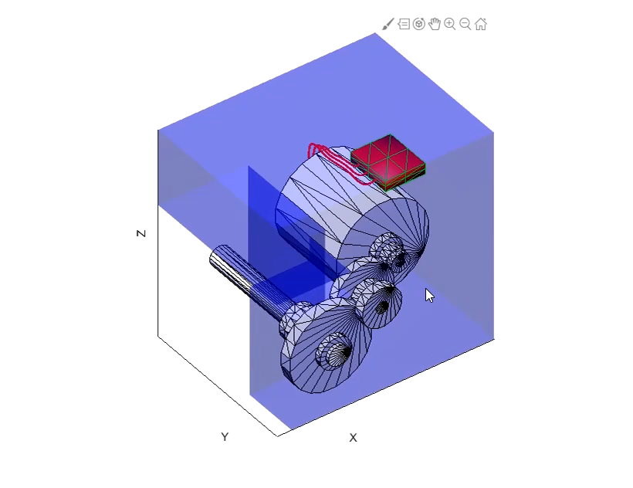
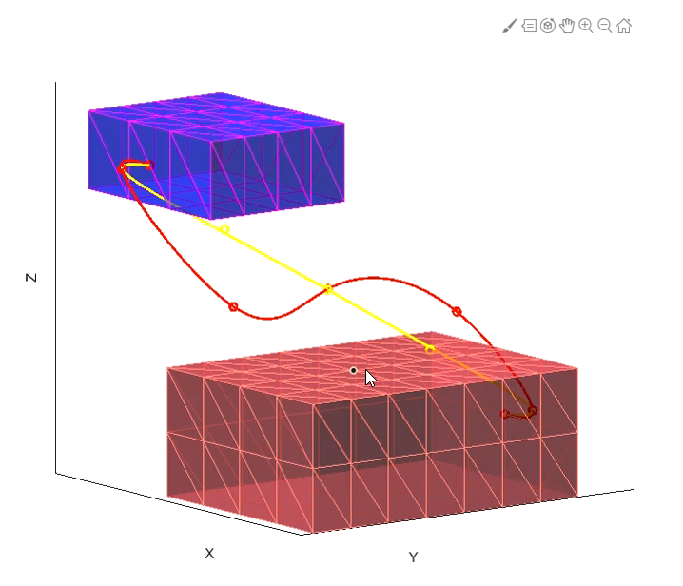
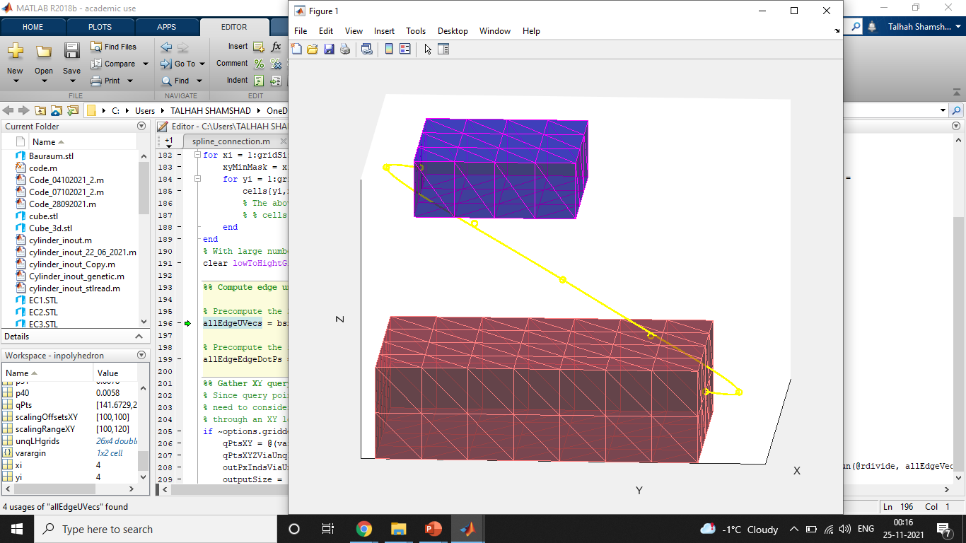
Chair of Computational Modeling and Simulation TUM School of Engineering and Design Technical University of Munich
Implemented Algorithm
Cable connections (Spline generation)
Input:
Cable diameter
Radius of curvature
Characteristics
Length
Maximum curvature
Collision with components
20

Slide 21
Implemented Algorithm
Chair of Computational Modeling and Simulation TUM School of Engineering and Design Technical University of Munich
21

Slide 22
Implemented Algorithm
Chair of Computational Modeling and Simulation TUM School of Engineering and Design Technical University of Munich
Function NewGeneration:
Selection
Crossover
Mutation
Fitness of current generation is sorted to get median and mean values.
Selects top half based on fitness and saves it for the new generation.
Selects two parents based on fitness to create two children
Combines the variables of the two parents using a weight factor to create two children.
Mutates all the variables in order to add diversity to the new population.
Probability and amplitude of mutation remains constant across all generations.
22

Slide 23
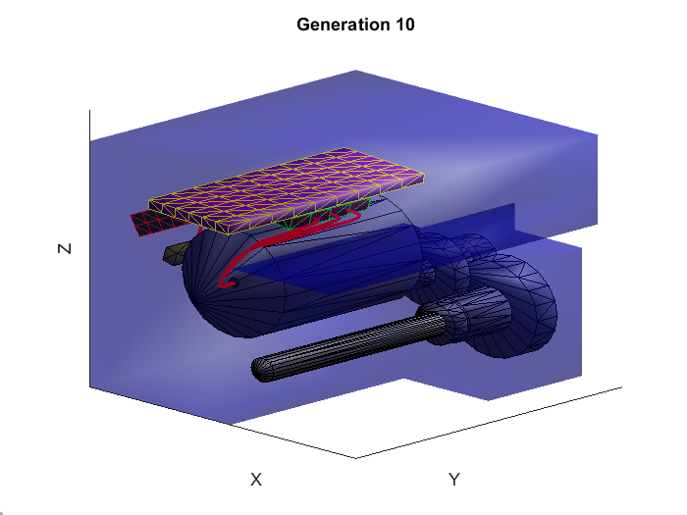
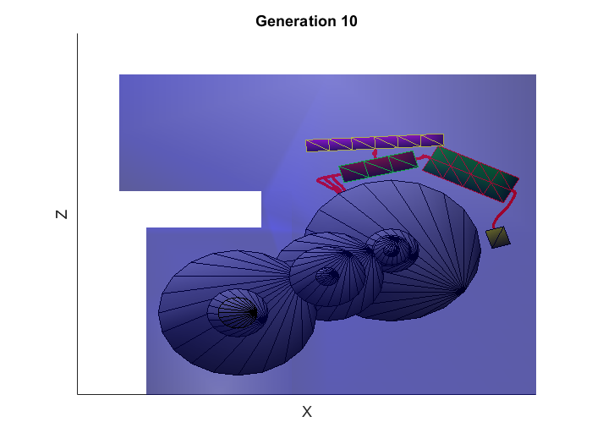
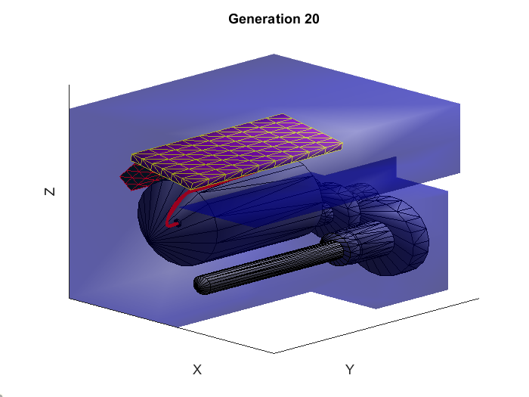

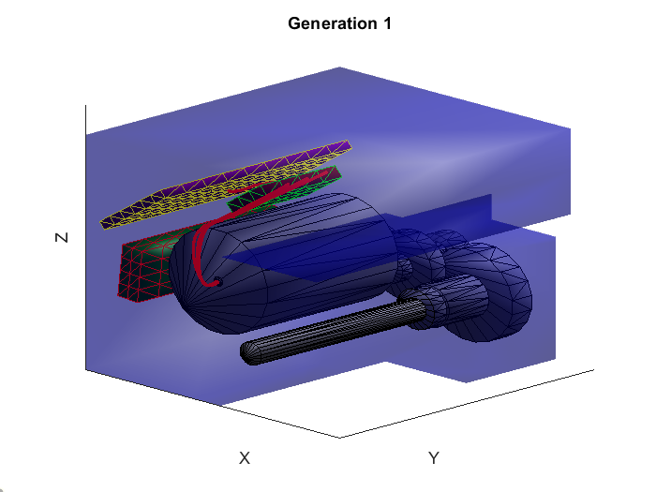
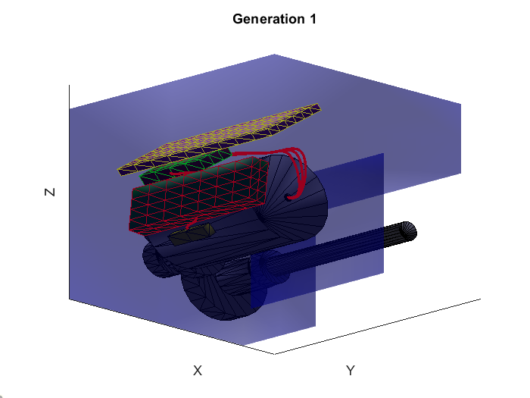
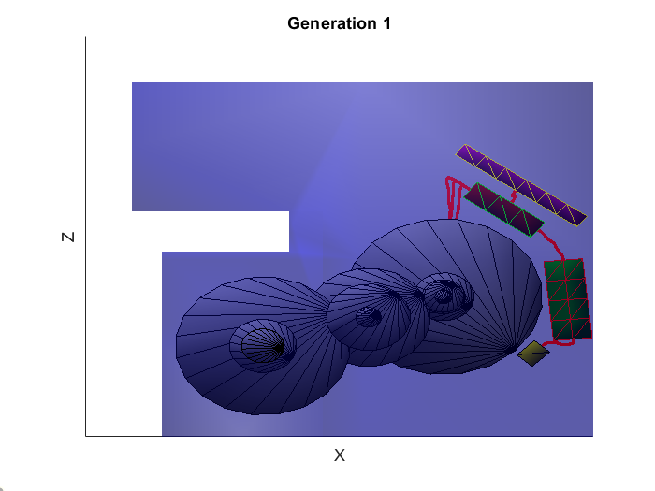
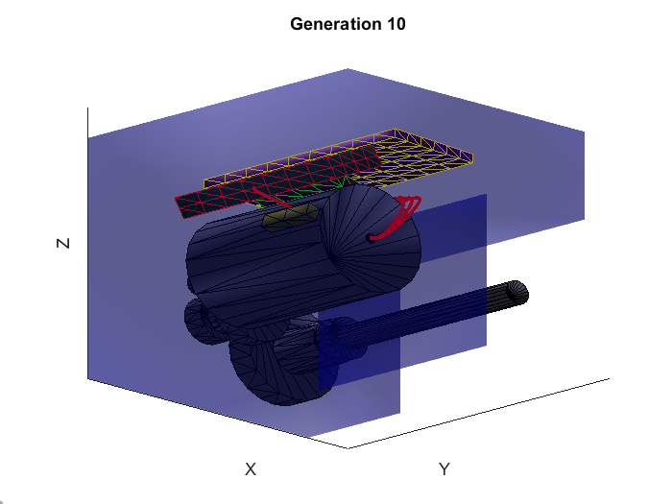
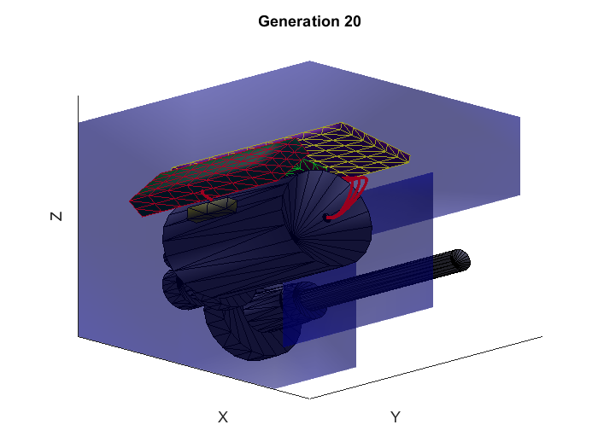
Results
Chair of Computational Modeling and Simulation TUM School of Engineering and Design Technical University of Munich
From the start the algorithm develops decent solutions.
The next generations succeed in moving the components closer.
There are generations where a better solution cannot be found, so it sticks with the same best individual from the previous one.
*Results show the best individual of each generation for a run with 100 individuals in 10 generations with general bauraum.
23

Slide 24
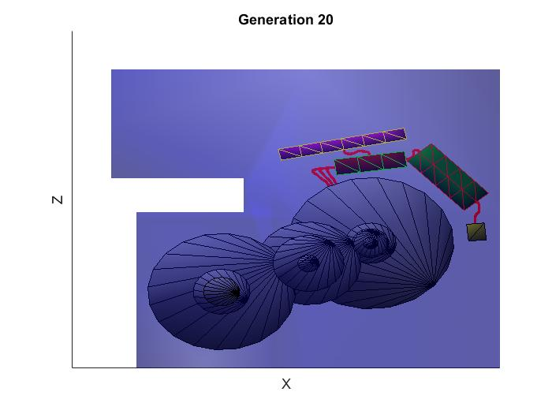
Results
Chair of Computational Modeling and Simulation TUM School of Engineering and Design Technical University of Munich
Not only the best individual of the population is a good solution; the entire population has a considerable increase in fitness. In the final set of individuals at least half can be considered good solutions.
24

Slide 25
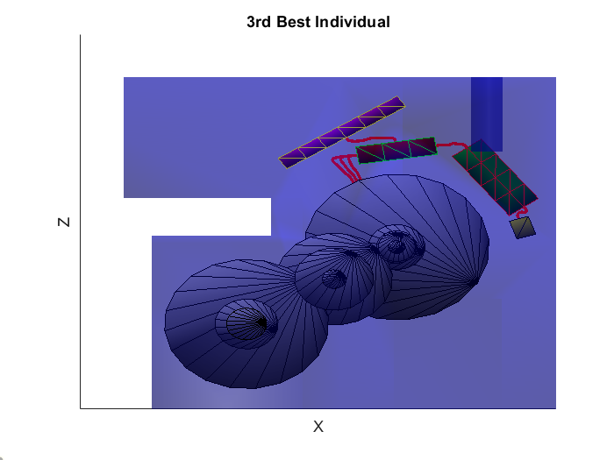
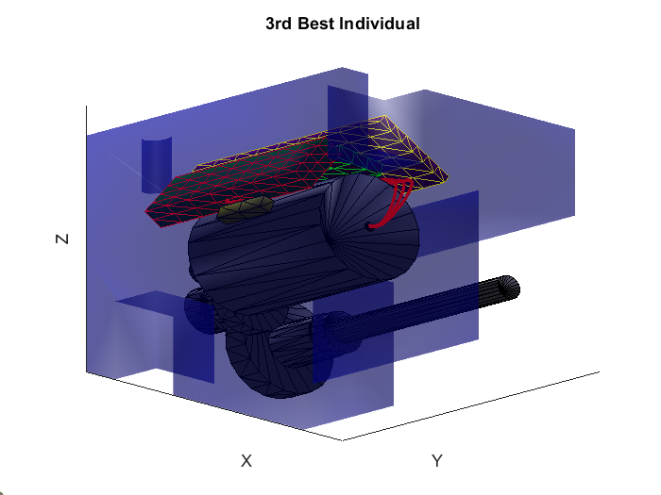
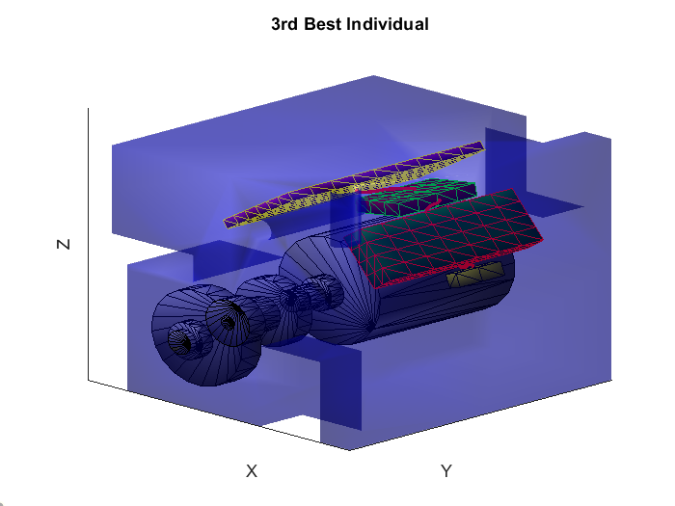
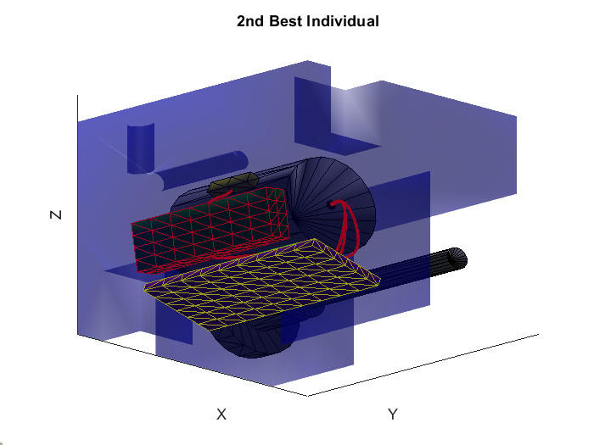
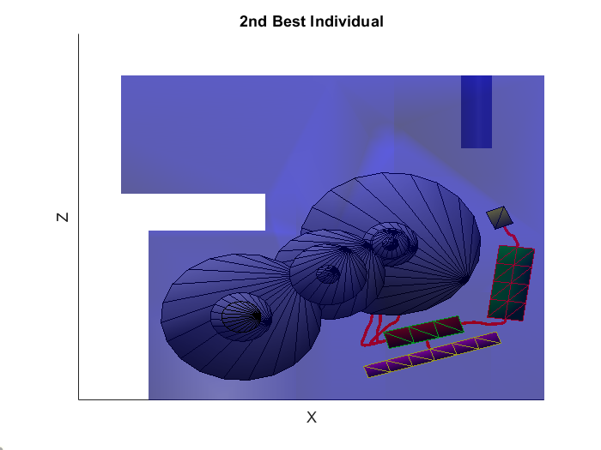
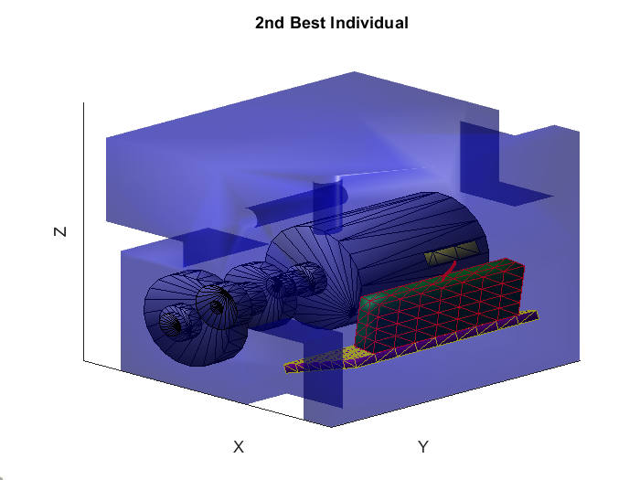
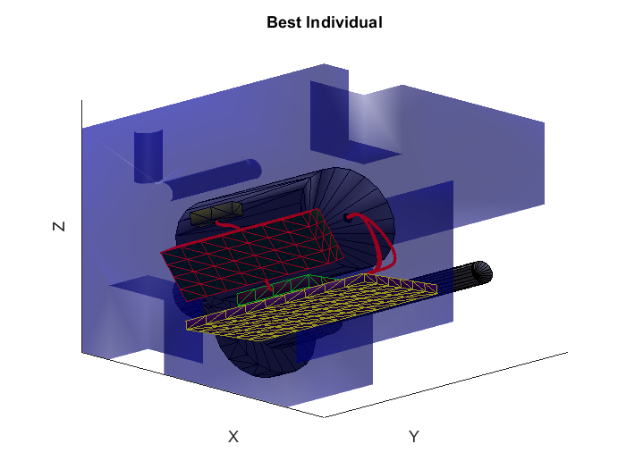
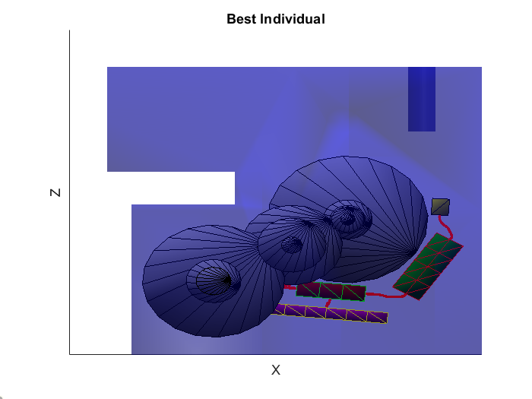
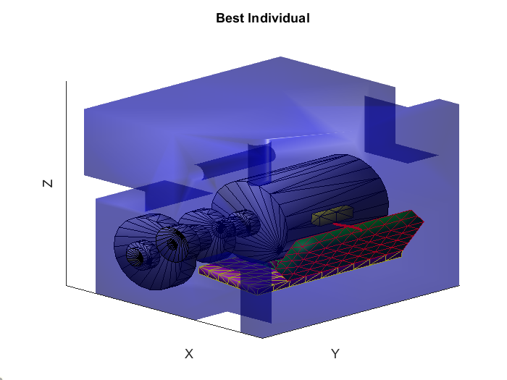
Results for a run with 500 individuals in 20 generations using a bauraum with holes and obstacles.
Chair of Computational Modeling and Simulation TUM School of Engineering and Design Technical University of Munich
In the last generation, there are many individuals that can be considered good solutions.
An increase in population size comes with an increase in computation time.
*Results show the best individual of each generation for a run with 500 individuals in 20 generations
25

Slide 26
Chair of Computational Modeling and Simulation TUM School of Engineering and Design Technical University of Munich
Results for a run with 500 individuals in 20 generations using a bauraum with holes and obstacles.
In a more realistic case, the bauraum could contain obstacles that reduce the available space. The algorithm does a good job in finding a solution that avoids these obstacles.
26

